Slide 1
Movie Review NLP
Final Presentation
Andrew Bryan

Slide 2
Problem Statement
Problem Statement
Scope
Client
How can a natural language processing (NLP) method be developed to determine the sentiment of movie reviews based solely on the text within the review, in order to improve the accuracy of movie scores on Rotten Tomatoes?
- The scope includes creating a model that would be able to accurately
assess any movie review written and determine whether the user liked the movie or not.
Client: Rotten Tomatoes
Key Stakeholders:
CEO Patrick Lee

Slide 3
Data Wrangling and Cleaning

Slide 4
Data Deep-dive
Wrangling
Exploring & Learning
The dataset being used was obtained from Kaggle and consisted of 50,000 movie reviews and the overall sentiment for each.
The dataset consisted of 50,000 instances
It only contained two columns - one to be treated as the feature set, the second as the output
The dataset is perfectly distributed with 25,000 positive reviews and 25,000 negative reviews
Investigation revealed 0 null values

Slide 5
Exploratory Data Analysis

Slide 6
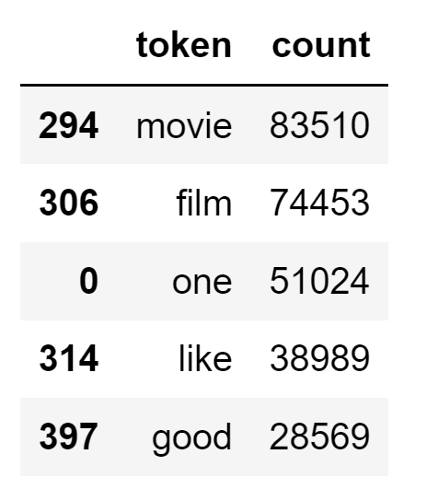
Initial Analysis
Tokens were created from the movies reviews, which allowed for some initial visualization. Below is a table of the top 5 used tokens (words) and on the next slide is a histogram of the top 75 used tokens (words).

Slide 7
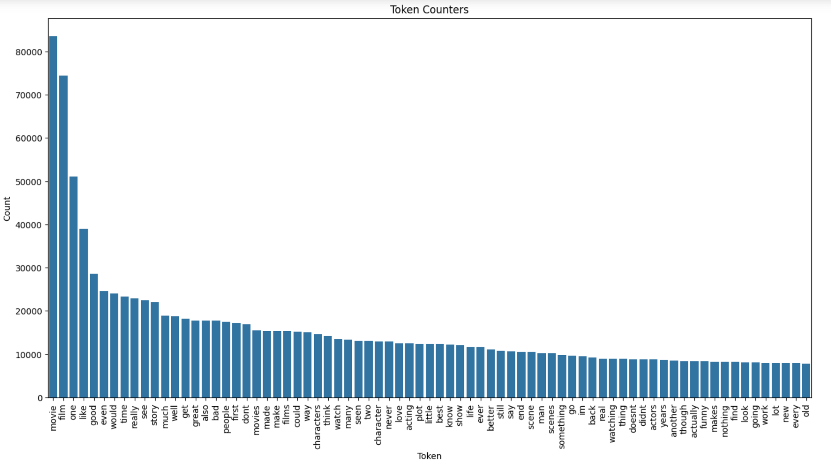

Slide 8
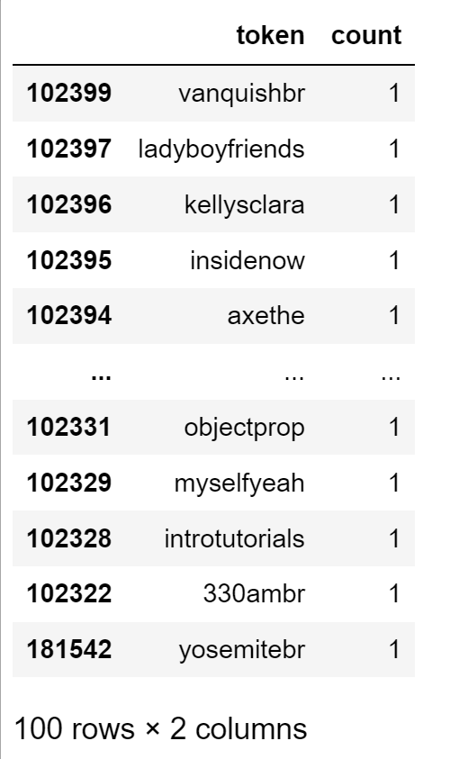
Cleaning
There was some slight cleaning needed, as investigation revealed a large number of tokens that only had a count of 1 to 3 uses across 50,000 movie reviews. Once those were looked at, it was clear that they were typos. Therefore, the decision was made to only include tokens with more than 3 uses, which is the point when the tokens were mostly real words.

Slide 9
Modeling

Slide 10
Modeling Approach
TFIDF
Word Embeddings
AI API
Term Frequency-Inverse Document Frequency (TFIDF) was selected as an approach for modeling technique since this approach will value words based on frequency of use. For example positive words and negative words would carry more weight and affect the outcome.
The Word2Vec package was installed and used for a word embeddings approach. This would better allow for capture of meaning instead of only word usage.
Finally, an approach was used that utilized an api with a chat bot (Open AI in this case) to feed the review and receive back a positive or negative sentiment.

Slide 11
TFIDF Execution
Both random forest and nearest neighbor were used for a traditional machine learning approach with TFIDF
Problem Statement
Random Forest
Nearest Neighbor
Random Forest proved to be the best model for fitting the TFIDF approach - on the test set, this approach boasted an accuracy of 85%
Grid search cross validation was performed on the training set, but the original hyper parameters resulted in the best accuracy score.
Nearest Neighbor was not as successful as Random Forest, but not by much. The best model after testing various values for k was 77% accuracy.

Slide 12
Word Embeddings Execution
For the word embeddings approach, random forest was selected since it was the model that had the best results with TFIDF
Problem Statement
Random Forest
Word2Vec was installed and utilized for this approach.
An extra step was involved for the word embeddings approach, as this route requires the tokens and a vector created from them.
After a vector was created for each review, the random forest model was fit and the testing results showed an 84% accuracy, very similar to the TFIDF model.

Slide 13
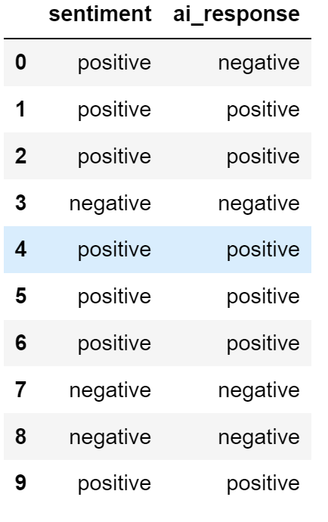
AI API
Problem Statement
For the AI API approach, an API key was obtained with Open AI, which would be utilized to analyze the movie review and return positive or negative, indicating the sentiment of the review.
This model resulted in 94% accuracy. Clearly the Chatbot is better at analyzing movie reviews for their overall sentiment than traditional machine learning and NLP.
The snippet on the right, just shows a small sample of the results, but even in this subset of 10 instances, it is correct 9 out of 10 times.

Slide 14
Result
The AI API with Open AI was selected for the final model.

